Slide 1
Funding sources for young scientists in Austria
by
Dr. Maria T. Pérez Mediavilla
Service Center Research
Stand 20.05.20016

Slide 2
How to find information about funding agencies and programmes?
Homepage Service Center Research/ Newsletter
Come to the Service Center Research!! We will give you advice, information, and, if wished, feed-back on your proposal
Ask more experienced colleagues…
ELFI-ELectronic Funding Information system (ELFI Database)! http://www.elfi.com

Slide 3
Where to start?
Choice of the funding agency/programme
Carefully read the application guidelines
Who is meant to be the target of the funding programme?
Requirements to observe: age, qualification, experience, country of residence
What type of projects/topics will receive funding? (e.g. clinical research, basic research, cardiovascular diseases..)
Is there a research focus (e. g. ÖnB Anniversary Fund: organ replacement and transplantation)?

Slide 4
Main funding sources for young scientists in Austria
Medical University of Innsbruck: MUI-START Programme
Austrian Science Fund (FWF): several programmes
National Bank of Austria : Anniversary Fund (ÖnB Jubiläumsfonds)
Tiroler wissenschaftsfonds (TWF)

Slide 5
Funding sources for young scientists in Austria
MUI-START Programme - Objectives
Target group: high qualified scientists at the beginning of their scientific careers
Objectives
Enable young researchers to collect preliminary data that might serve as basis for a third-party funding application (e. g. FWF Stand-Alone)
Help young scientists to launch their scientific careers

Slide 6
Funding sources for young scientists in Austria
MUI-START Programme – Basic information (I)
Prerequisites
MUI employment contract
Completed doctoral studies
Age limit (exceptions can be made e. g. parental leaves)
Experience in proposed research field (2 publications as first author)

Slide 7
Funding sources for young scientists in Austria
MUI-START Programme – Basic information (II)
Submission of applications: once a year (usually March-April)
Duration: max. 24 months
Grant amount: € 30.000 per project – Costs for personal only in special cases under appropriate argumentation (marginal employment contract)
Approval rate: 25-30%
Peer-reviewed outside Austria

Slide 8
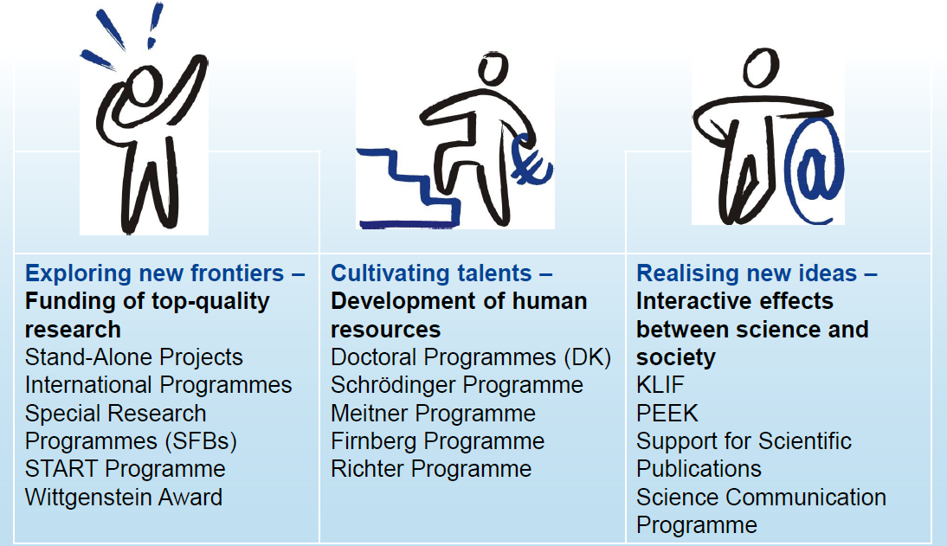
Austrian Science Fund - FWF
The FWF funding portfolio

Slide 9
Austrian Science Fund - FWF
Stand Alone Projects – Basic Information (I)
Target group: Scientists of any discipline working in Austria
Goal: Funding of individual research in the area of non-profit oriented scientific research
Requirements
High scientific quality measured on an international scale
Possible to fund your own position (independent applicant) if you have lived at least 3 years in Austria during the last 10 years or if you have been working as a scientist in Austria during the two years preceding your application
No age limit

Slide 10
Austrian Science Fund - FWF
Stand Alone Projects – Basic Information (II)
Submission of applications: on a rolling basis
Duration: up to 48 months (possibility of extending the funding period but not the budget )
Grant amount: Max. € 400.000 per project (generally 1 Post-doc + 1 Ph. D. candidate + 10-15 % other costs).
Processing time: 4-6 months
Approval rate: ca. 26%

Slide 11
Austrian Science Fund - FWF
KLIF Programme – Objectives
Target group: all clinical scientists working in Austria who possess the appropriate qualifications, sufficient working capacity and the infrastructure necessary to carry out the project
Goals
To fund projects in the field of non commercial clinical research that are thoroughly described in terms of objectives and methods
Projects must involve human patients or healthy subjects and the aim must be to generate new scientific knowledge and insights that improve clinical practice and patient treatment

Slide 12
Austrian Science Fund - FWF
KLIF Programme – Basic information (I)
Requirements
Evidence of preparatory work related to the proposed study
International publications
Project must involve human patients or healthy subjects
No direct commercial interest in the results
Program-specific requirements
Positive opinion from the ethics commission or evidence of a fundamental approval/endorsement by that commission
Projects may be co-funded. In such cases, the applicant must submit a declaration defining the nature of that collaboration. Organizations co-funding projects cannot act as sponsors
Costs of animals and animal care will (generally) not be financed

Slide 13
Austrian Science Fund - FWF
KLIF Programme – Basic information (II)
Submission of applications: on a rolling basis (no deadlines!)
Duration: up to 48 months (possibility of extending the funding period but not the budget )
Grant amount: Max € 400.000 per project (generally 1 Post-doc + 1 Ph. D. candidate + 10-15 % other costs)
Processing time: 4-6 months
Approval rate: ca. 12%

Slide 14
Austrian Science Fund - FWF
KLIF Programme – Project description
Methods and research design
Type of study (classification)
Precise description of planned interventions
Description of methods to be applied
Relevant criteria for inclusion/exclusion
Primary and secondary endpoints of the study
Risk assessment
Biometric data/statistical analyses (including power calculations), size of sample
Methods of preventing bias
Recruiting availability of patients/subjects
Gender aspects
Rules of good clinical practice, GLP and GMP must be observed

Slide 15
Austrian Science Fund -FWF
START Programme - Objectives
Target group: Young, outstanding researchers of all disciplines, no quotas
Goal: Provide young researchers with long-term, and extensive financial security to build up or consolidate their own research group - qualification for leading scientific positions in Austria or abroad

Slide 16
Austrian Science Fund -FWF
START Programme – Basic information (I)
Prerequisites
The doctoral degree must have been completed (award of certificate) at least 2 to a max. of 8 years before submission of the application (application deadline)
Exceptional international track record
Proven scientific independence (competitive third-party funds)
International experience (Research stay abroad min. 1 year)
Application to ERC-Start or ERC-Consolidator
Possibility to fund your own position, access to the university working infrastructure has to be warranted

Slide 17
Austrian Science Fund -FWF
START Programme – Basic information (II)
Application: once a year; call opens in July till mid September – Decision : in June next year
Duration: 72 months (3 + 3 years) – Interim evaluation after 3 years
Funding: personnel and non personnel costs (min. € 800.000 to max. € 1,2 Mio)
Approval rates: ca. 8 % (5-6 grants a year)
Decision: Peer-reviewed applications/ international jury of renown scientists from outside Austria, http://www.fwf.ac.at/en/about-the-fwf/organisation/start-wittgenstein-jury

Slide 18
Austrian Science Fund - FWF
Erwin Schrödinger Programme –Objectives
Target group: Young highly qualified scientists from any discipline (no age limit!)
Objectives
To enable scientists/researchers to work at leading foreign research institutions and to acquire international experience in the postdoc phase
To explore new scientific areas, methods, procedures and techniques so as to contribute - following return to Austria - to the further development of science in Austria

Slide 19
Austrian Science Fund - FWF
Erwin Schrödinger Programme – Basic information (I)
Prerequisites
Completion of doctorate (for degree programs in medicine in Austria, only certain curricula are eligible: N, O, Q 201; N, Q 094; N, O 790 or N 090)
Experience in proposed field of research
International publications
Programme-specific requirements
Reasons for selecting the research institution abroad + invitation
Recommendation of Austrian research institution and information about opportunities upon return / requested return phase
Explanation of how the know-how gained through the fellowship can be used later in Austria

Slide 20
Austrian Science Fund - FWF
Erwin Schrödinger Programme – Basic information (II)
Submission of applications: on a rolling basis
Grant amount: 32,600 – 47,400 € / year (tax-exempt); travel costs (up to 1,800 € depending on destination); lump sum for children accompanying researcher (up to 4,200 € / year); conference attendance (up to 1,800 € / year); pension insurance contributions
Return phase in Austria with senior postdoc salary plus 10,000 € / year in project-specific costs
Duration: 10 to 24 months (abroad) + 6 to 12 months (return phase)
Approval rate: Approximately 42 % (highest approval rate at FWF!!)

Slide 21
Austrian Science Fund - FWF
Austrian Science Fund - FWF
Erwin Schrödinger Programme – Basic information (III)
Criteria for project descriptions
Ethical issues
Reason for selection of research institution abroad
Information on return phase; implementation of know-how in Austria
Criteria for formal requirements
Declaration from host institution
Declaration regarding ethics (with questionnaire)
Invitation of research institution abroad
Affirmation of the research institution (return phase)

Slide 22
Austrian Science Fund - FWF
Hertha Firnberg Programme – Objectives
Target group:
Postdocs of all disciplines; applicants must not already hold a permanent position at a research institution
Objective(s)
To provide as much support as possible at the beginning of a female scholar's academic career or upon her return from maternity leave
To enhance career opportunities for women in science and academia
To enhance the integration of women in research

Slide 23
Austrian Science Fund - FWF
Hertha Firnberg Program – Basic information (I)
Prerequisites
International publications
Doctorate for degree programmes in medicine in Austria, only certain curricula are eligible: N, O, Q 201; N, Q 094; N, O 790 or N 090)
Programme-specific requirements
Co-applicant (mentor) at the host research institution
Letter of support from research institution
Career plan (signed by the co-applicant and head of research institution)
Letter of support regarding funds for teaching

Slide 24
Austrian Science Fund - FWF
Hertha Firnberg Programme – Basic information (II)
Calls: 2 calls per year (spring/fall), decisions announced in November/June; Present call : 11. April - 31. May 2016
Approval rate: ca. 25 %
Grant amount: Postdoc salary, + 12,000 € / year, including 2,000 € for coaching or HR development measures
Project duration: 3 years, including possibility of 12 months abroad (with consent of employer (“Entsendung”); reasons and invitation must be enclosed with application)

Slide 25
Austrian Science Fund - FWF
Hertha Firnberg Programme – Basic information (II)
Criteria for project descriptions
Institutional integration, available infrastructure and personnel
Scope and significance of national and international cooperation arrangements
Criteria for formal requirements
Program-specific data with declaration from co-applicant
Applicant's career plan
Co-applicant's CV and list of publications
Letter of recommendation from co-applicant
Letter of support regarding funds for teaching activities
Invitation from research institution abroad (if necessary)

Slide 26

Austrian National Bank – Anniversary fund
Target group: young and senior postdocs and senior scientists
Goal: Support top-level scientific research work in the fields of economics and medicine (disease-oriented and patient-oriented clinical research); medical scientific research that is not clinical is not eligible for funding.

Slide 27
Austrian National Bank – Anniversary fund
Anniversary fund - Basic information (I)
Prerequisites:
Completed doctoral studies
Research must be carried out (mainly) in Austria
Research projects must deal with disease-oriented or patient-oriented clinical research
Animal testing is explicitly forbidden
Only non-commercial and non-profit-oriented research
Medicine research focus : Organ replacement and transplantation

Slide 28
Austrian National Bank – Anniversary fund
Anniversary fund - Basic information (II)
Submission of applications: 2 deadlines a year (January and July); decisions June and December
Grant amount: between €10.000 and € 110.000 – up to € 200.000 for projects within research focus
Duration: max. 4 years
Approval rate: around 20 %

Slide 29
Regional government of Tyrol - TWF
Agency | Regional Government of Tyrol https://www.tirol.gv.at/bildung/wissenschaftsfonds/
Type | Tiroler Wissenschaftsfonds (TWF)
Target group | Young scientists/Postdocs
Goal | To support basic or applied research projects within particular focus areas defined by each research institution (LFU, MUI, UMIT, FHG, MCI, FH Kufstein, PH Tirol)
Requirements | Max. 35 years old (parental leaves are taken into account) or highest degree max .7 years before deadline
Length | 12 to 36 Months
Level | Up to 100.000,-€ personal and material costs (MUI 40.000,-€)
Deadline | 1 deadline a year Spring (01.02.2016 – 31.03.2016)
Language | Forms in German, proposal in English
Contact person MUI: Eva Mayrgündter
E-mail: Eva.Mayrguendter@i-med.ac.at

Slide 30
Horizon 2020 -Marie Sktodowska Curie actions
Source | Marie Sktodowska-Curie Actions http://ec.europa.eu/research/mariecurieactions/
Type | Individual Fellowships (IF)
Target group | Promising young scientists/Postdocs
Goal | To support the best, most promising individual researchers from anywhere in the world
Requirements | Completed doctoral studies or four years full-time research experience after the Master Mobility across borders is a must. Cross-sectoral mobility is also encouraged. All research areas - Excellent Science
Length | European Fellowships (1-2 years); Global Fellowships (2-3 years)
Costs | Living allowance, travel costs, project specific costs, overheads
Deadlines | Call opens 12.04.2016 and ends 14.09.2016 17:00 Brussels local time)
Language | English
Approval rate | < 20 %
Contact person: Dr. Wolfram Rieneck; E-mail: Wolfram.rieneck@i-med.ac.at

Slide 31
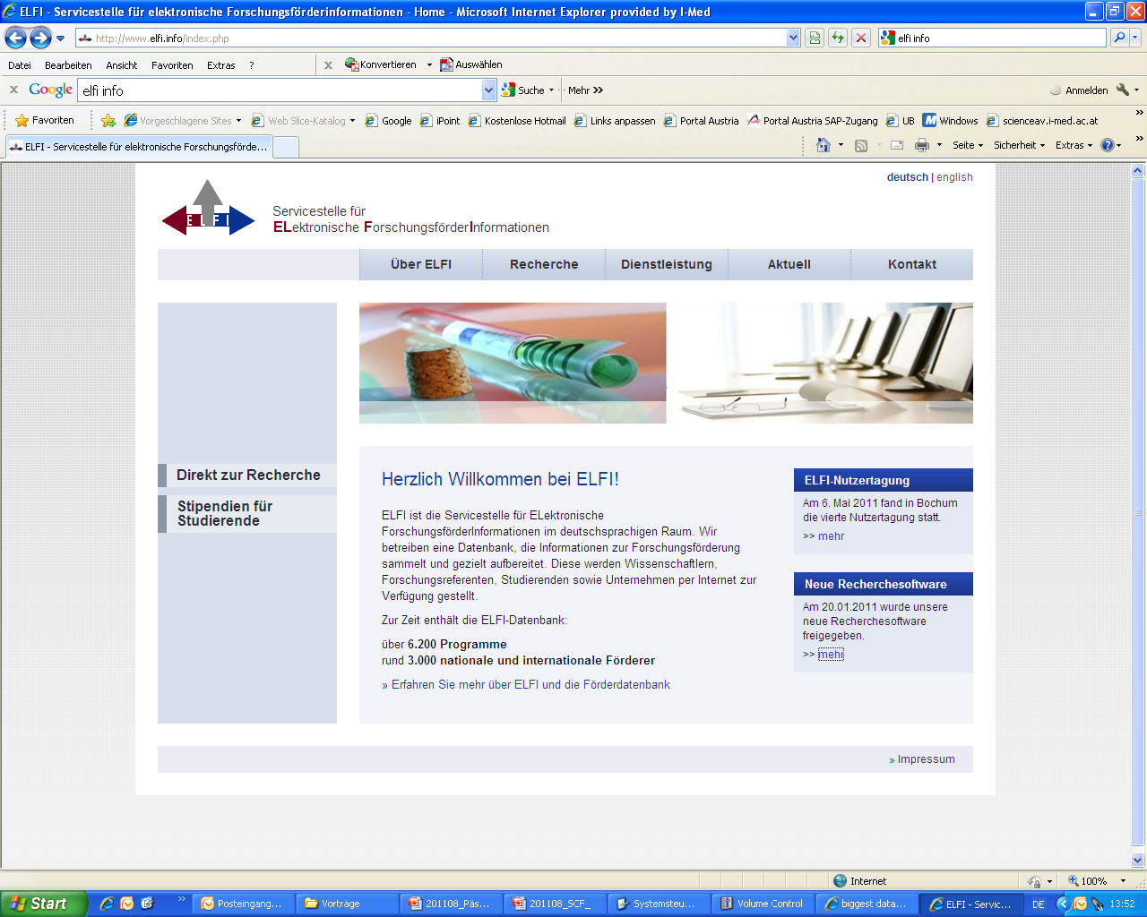
ELFI-ELectronic Funding Information system http://www.elfi.info/index.php
Search with your own profile:
Research field
Region
Agency (e. g. FWF)
Type of funding (e. g. fellowship, project, award, etc…)
Open calls

